Slide 1
Exploring the Effect of Adverse Childhood Experiences on Cortisol

Slide 2
Background on Cortisol and Adverse Childhood Experiences (ACE)
In humans, cortisol is secreted throughout the day in a distinct pattern
Disruptions to the expected pattern have been linked to poor health outcomes (Engert et al., 2011)
ACE have been linked to poor health outcomes (Felitti et al., 1998)

Slide 3
Background on the Relationship between Cortisol and ACE
The HPA axis regulates the release of cortisol in humans
Chronic exposure to stressors can result in dysregulation of interactions between the HPA axis and the autonomic and immune systems, resulting in poor health outcomes (elevated blood pressure, increased heart rate, etc.) (McEwen, 2006)

Slide 4
Project Aim
To provide addition information on the relationship between ACE and indicators of HPA axis functioning (diurnal cortisol measures) using data from the Midlife in the United States Study

Slide 5
Data
Data come from the Midlife in the United States Study (Ryff et al., 2007)
Dependent variable: participants used home-sample kits to collect 4 salivary cortisol samples per day for 4 consecutive days
Independent variable: this study’s measure of ACE is a sum score of 7 binary variables indicating:
Whether the individual’s family was on welfare or Aid to Dependent Children
Whether the individual’s mother and/or father had less than 12 years of education
Whether the individual did not live with their biological parents due to their parents being separated/divorced
Whether the individual did not live with their biological parents due one or both parents dying
Whether the mother/woman and/or father/man who raised the individual (1) emotionally abused them, (2) physically abused them, and/or (3) sexually abused them

Slide 6
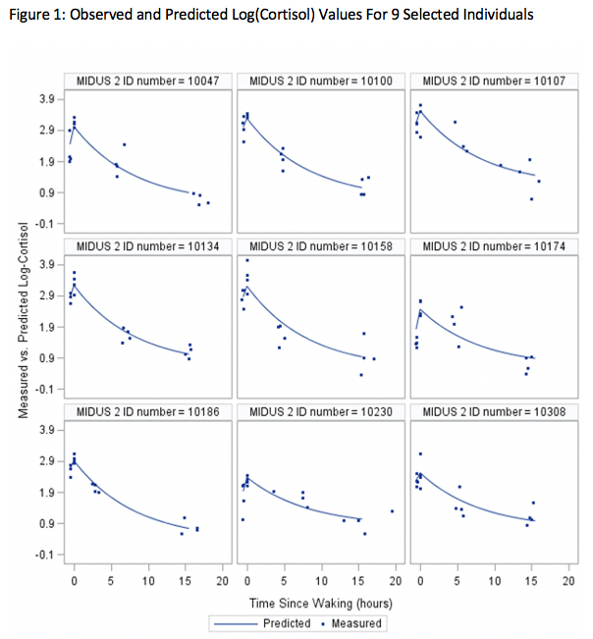
Visualizing Daily Trajectories of Cortisol

Slide 7
Missing Data
This study uses cortisol measures from 1,020 individuals
Of the 1,020, 883 participated in the second wave of the Midlife in the United States Study from which 6 of the 7 measures of ACE were drawn
Of the 883, only 492 individuals participated in the first wave of the Midlife in the United States Study from which the 7th measure of ACE was drawn

Slide 8
Missing Data Handling
Multiple Imputation is a missing data handling strategy that will allow us to make use of all 883 observations by filling in ACE measures that are missing for the 391 individuals who did not participate in the first wave
Multiple Imputation fills in the missing data such that variances, correlations, and uncertainty regarding the variances and correlations in the data are preserved

Slide 9
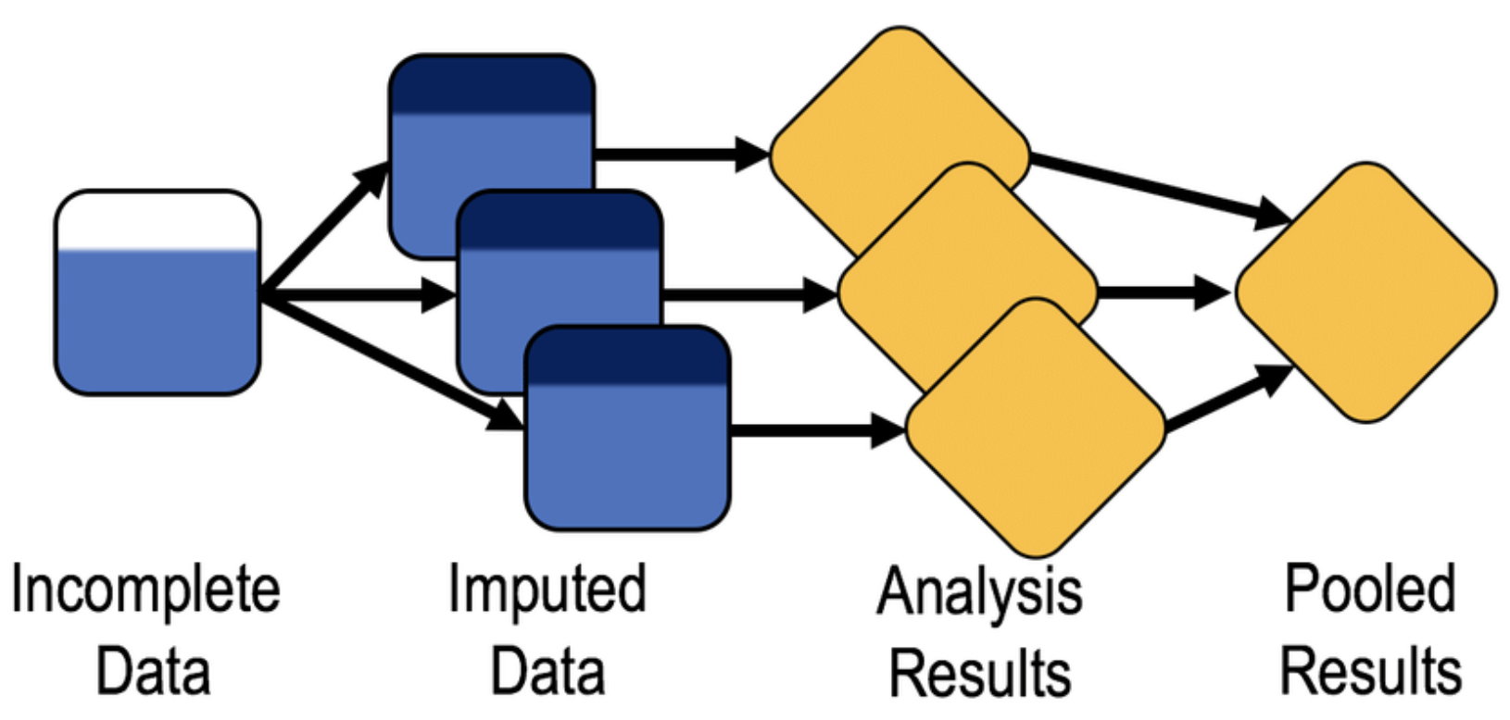
Multiple Imputation
Imputation phase: use the R package ”mice” to fill in 20 imputed versions of the data
Analysis phase: fit the substantive model of interest to each of the imputed sets
Pooling phase: use Rubin’s pooling rules to pool the parameter estimates from each of the imputed sets

Slide 10
Analysis
A multilevel two-phase model was used to address the nonlinear trajectory of daily cortisol secretion
Multilevel models address dependencies in the data due to repeated measures being nested within individuals

Slide 11
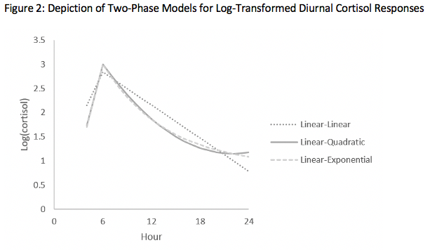
Phases of the Multilevel Two-phase Model
The 1st phase (1st to 2nd measure) was modeled as linear
The 2nd phase (2nd to 4th measure) was modeled as linear, quadratic, and negatively-accelerated exponential
Negatively-accelerated exponential was selected as the best fitting function

Slide 12

Linking the Two Phases of the Model
The parameter $τ_{di}$ represents the continuous transition from the first phase to the second phase, specific to the $d$^{th} day and the $i$^{th} individual

Slide 13
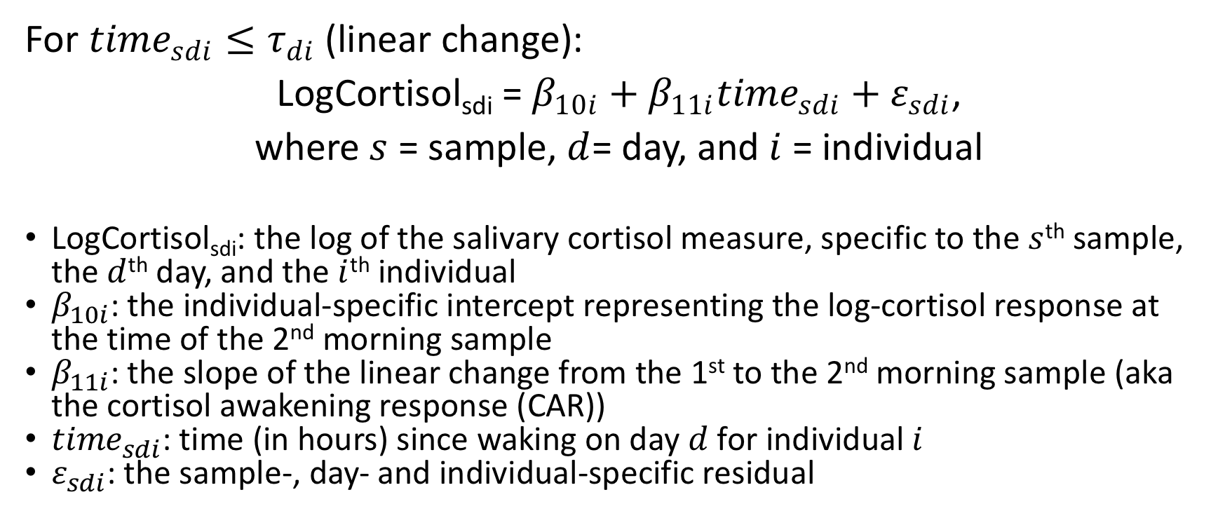
The Two-phase Unconditional Multilevel Model
For ${time}_{sdi}≤τ_{di}$ (linear change):
LogCortisol_{sdi} = $β_{10i}+β_{11i}{time}_{sdi}+ε_{sdi}$,
where $s$ = sample, $d$= day, and $i$= individual
LogCortisol_{sdi}: the log of the salivary cortisol measure, specific to the $s$^{th} sample, the $d$^{th} day, and the $i$^{th} individual
$β_{10i}$: the individual-specific intercept representing the log-cortisol response at the time of the 2nd morning sample
$β_{11i}$: the slope of the linear change from the 1st to the 2nd morning sample (aka the cortisol awakening response (CAR))
${time}_{sdi}$: time (in hours) since waking on day $d$ for individual $i$
$ε_{sdi}$: the sample-, day- and individual-specific residual

Slide 14
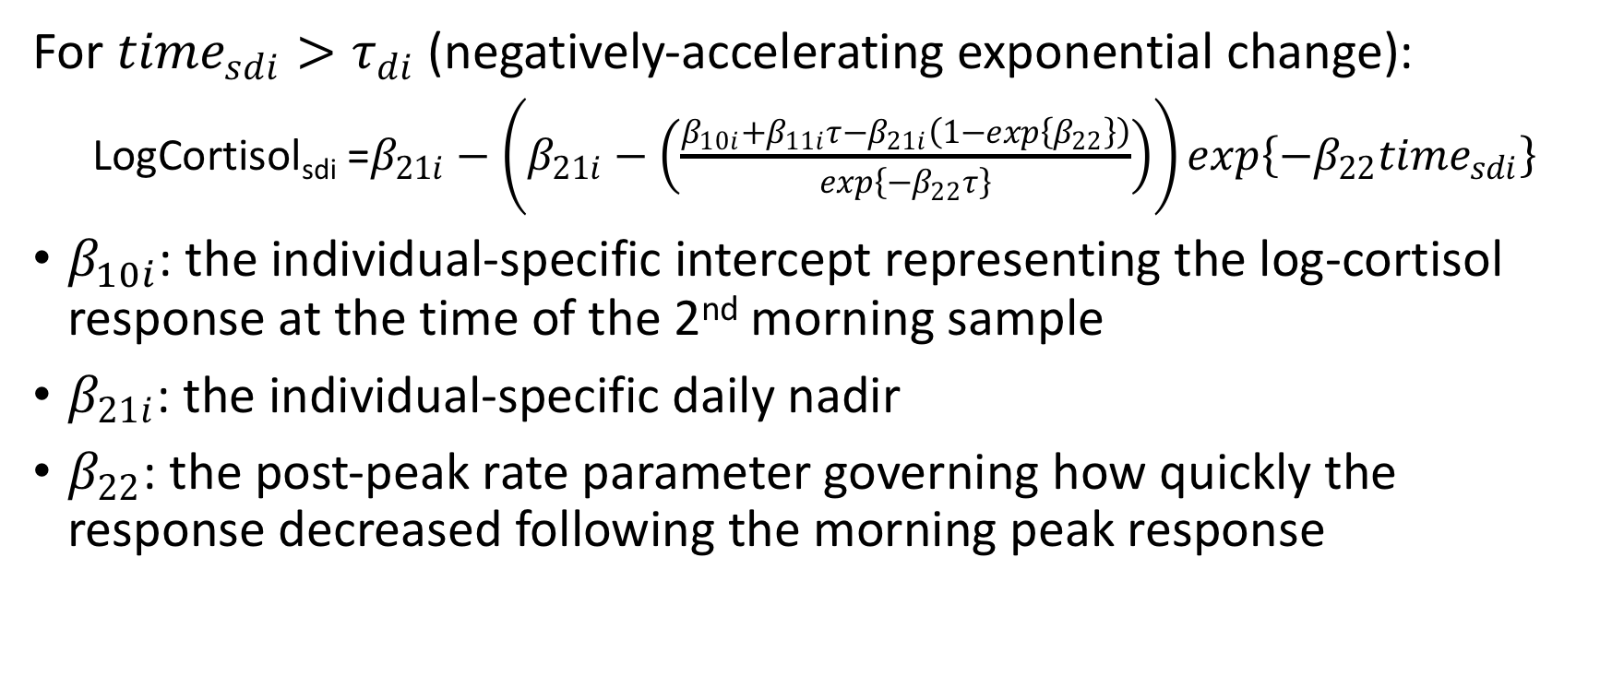
The Two-phase Unconditional Multilevel Model
For ${time}_{sdi}>τ_{di}$ (negatively-accelerating exponential change):
LogCortisol_{sdi} =$β_{21i}−\left(β_{21i}−\left(\frac{β_{10i}+β_{11i}τ−β_{21i}\left(1−exp\left\{β_{22}\right\}\right)}{exp\left\{−β_{22}τ\right\}}\right)\right)exp\left\{−β_{22}{time}_{sdi}\right\}$
$β_{10i}$: the individual-specific intercept representing the log-cortisol response at the time of the 2nd morning sample
$β_{21i}$: the individual-specific daily nadir
$β_{22}$: the post-peak rate parameter governing how quickly the response decreased following the morning peak response

Slide 15
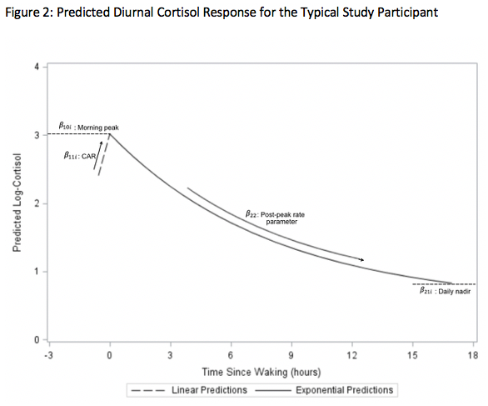
Visualizing the Two-phase Unconditional Model

Slide 16
Results
One of these multilevel two-phase models takes multiple days to converge
The model is fitted to each of the 20 imputed sets
For these reasons, results are pending

Slide 17
Software
SAS was used to clean the data and create exclusion criteria for problematic measures of cortisol
SAS was used to produce plots of the data
The R package “mice” was used for multiple imputation
SAS PROC NLMIXED was used to fit multilevel two-phase models to the imputed datasets
A UNIX server was used to speed up the analysis of 20 model fitting SAS scripts
SAS PROC MIANALYZE was used to pool the parameter estimates

Slide 18
References
Engert, V., Efanov, S. I., Dedovic, K., Dagher, A., & Pruessner, J. C. (2011). Increased cortisol awakening response and afternoon/evening cortisol output in healthy young adults with low early life parental care. Psychopharmacology, 214(1), 261-268. https://doi.org/10.1007/s00213-010-1918-4
Felitti, V. J., Anda, R. F., Nordenberg, D., Williamson, D. F., Spitz, A. M., Edwards, V., Koss, M. P., Marks, J. S. (1998). Relationship of childhood abuse and household dysfunction to many of the leading causes of death in adults: The Adverse Childhood Experiences (ACE) study. American Journal of Preventive Medicine, 14(4), 245-258. https://doi.org/10.1016/S0749-3797(98)00017-8
McEwen, B. S. (2006). Protective and damaging effects of stress mediators: Central role of the brain. Dialogues in Clinical Neuroscience, 8(4), 367-381. https://doi.org/10.31887/DCNS.2006.8.4/bmcewen
Ryff, C., Almeida, D. M., Ayanian, J. S., Carr, D. S., Cleary, P. D., Coe, C., ... & Mroczek, D. K. (2007). National survey of midlife development in the United States (MIDUS II), 2004-2006.

